Slide 1
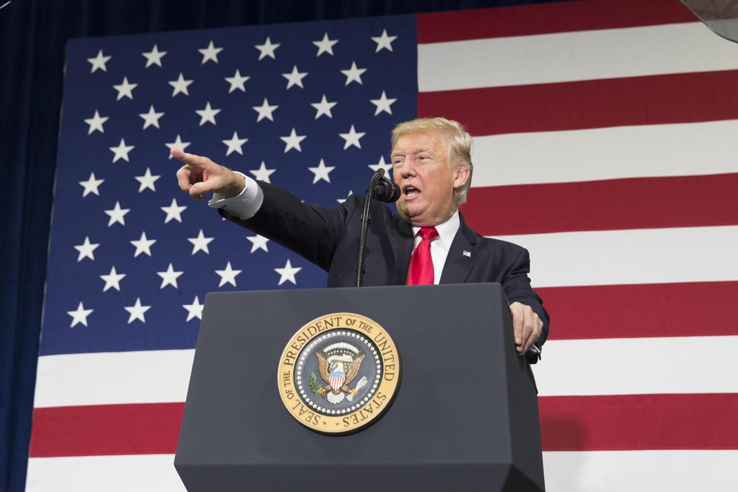
Group 2:
Fake News Detector
Ambrose
Guy
Aurele
Notes:
Guy

Slide 2
Agenda
1.
Overview of the problem
2.
Data pre-processing
3.
Models exploration
4.
Evaluation & critics
5.
Deployment
Notes:
Guy

Slide 3
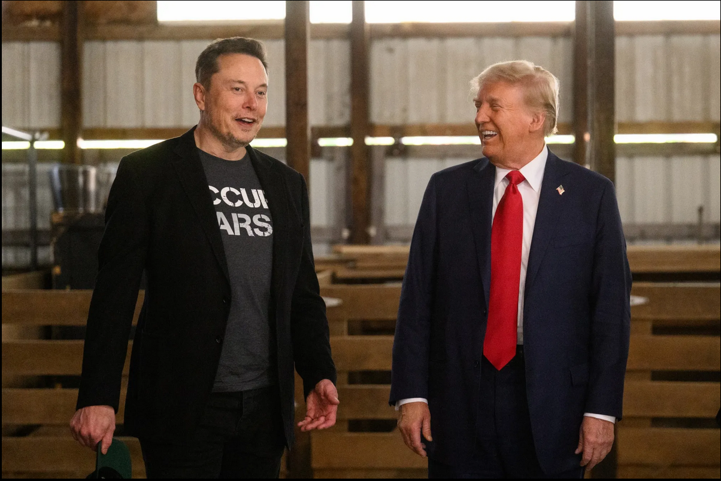
Overview of the problem
Notes:
Guy

Slide 4
Overview of the problem
Objective: Build a Fake News Detector using NLP models
Required to:
Test & assess multiple combinations of:
Data Cleaning
Natural Language Processing
Vectorization techniques
Modeling
Analyze results on test set to try to come up with optimizations
Notes:
Guy

Slide 5
Data pre-processing
Data cleaning:
Best model removes: URLs, numbers, double spaces, special characters…
Noticed a negative impact on removing stopwords for this exercise (Δ = 1.15% avg. acc.)
Word processing:
Lemmatization avg. acc. = 93.65% ⇒ 20 models tested
Stemming avg. acc. = 93.97% ⇒ 6 models tested
Low average difference but overall lemmatization achieved top acc. in most cases.
Language processing:
Bigram,
BoW, BoW Bigram/Trigram
TF-IDF, TF-IDF Bigram
TF-IDF + Trigram reached the best accuracy
Notes:
Aurele

Slide 6
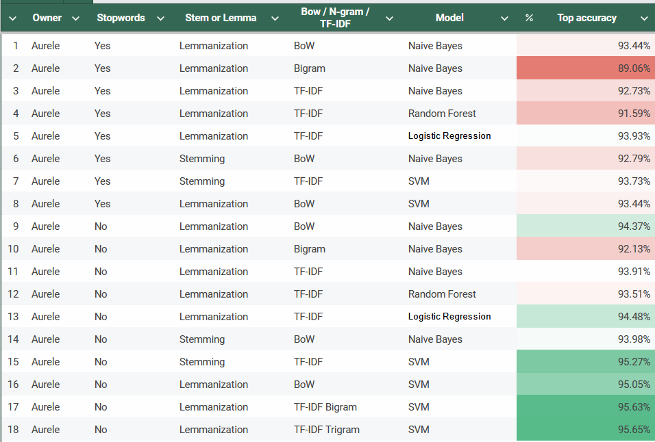
Over 30 models tested
Notes:
Aurele

Slide 7
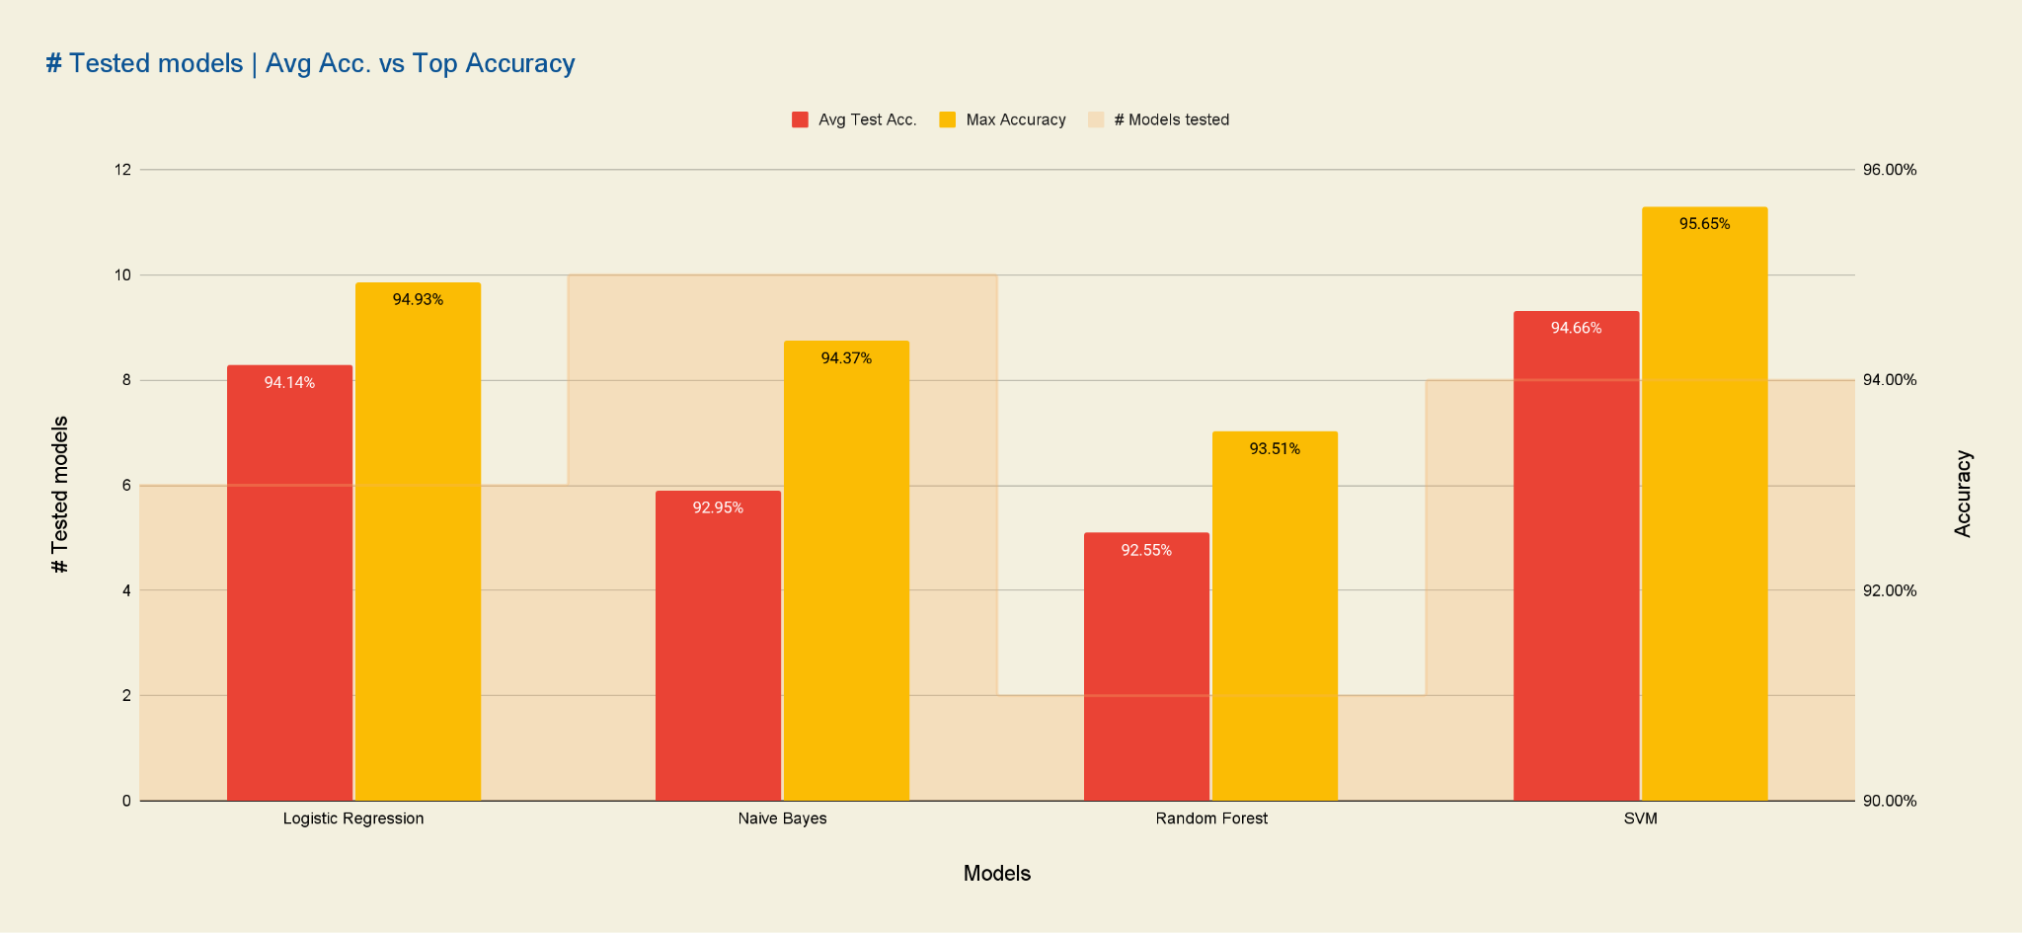
Result analysis over 26 selected models
Notes:
Aurele

Slide 8
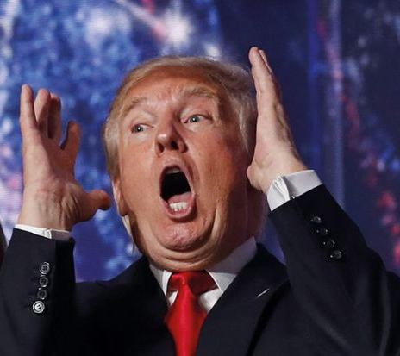

Top test accuracy - 95.65%
Stopwords included
WordnNet Lemmatizer
TF-IDF + Trigram
SVM model (kernel='rbf', gamma='scale', C=100.0)
Notes:
Aurle

Slide 9
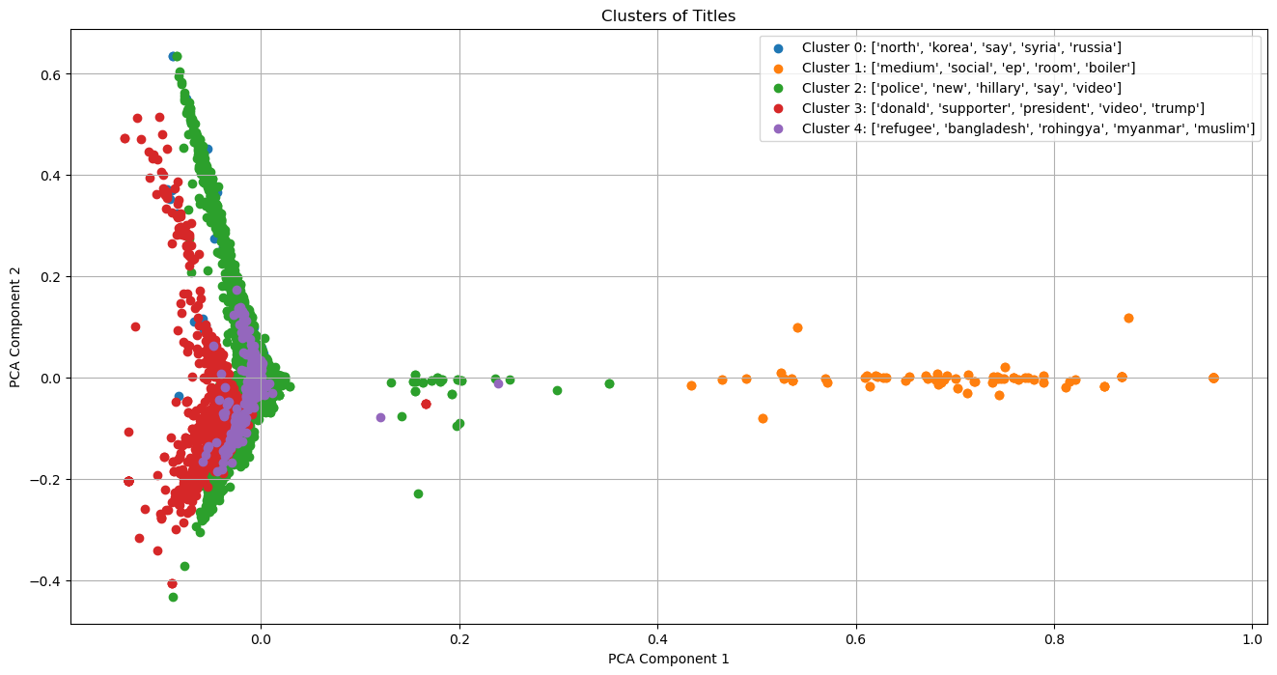
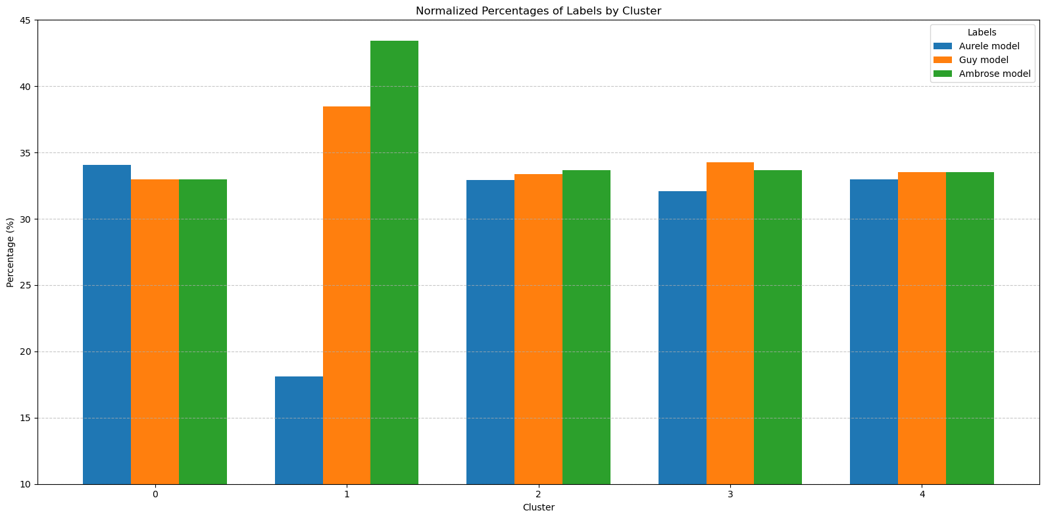
Evaluation
Defining the Problem
Science Presentation
We performed clustering of the titles according to repetitive keywords in the title.(The upper graph)
We got the following results:
Cluster 0: north, korea, say, syria, russia - 217 Titles
Cluster 1: medium, social, ep, room, boiler - 189 Titles
Cluster 2: police', 'new', 'hillary', 'say', 'video - 7961 Titles
Cluster 3: donald', 'supporter', 'president', 'video', 'trump - 1205 Titles
Cluster 4: refugee', 'bangladesh', 'rohingya', 'myanmar', 'muslim- 412 Titles
According to the keywords selected by the model, you can see that cluster number 1 has the least titles that are mostly far from being news titles
Following, we combined our best models accuracies results under the created clustering.(The bottom graph).
You can as well see that in the 1 cluster is a largest deviation between the models that could be caused but the title names that are not really related to the news titles
Conclusion:
The 1 cluster could be filtered out by preprocessing the data or by performing the clustering before data preprocess
If ignoring the 1 cluster we could see that the deviation between the models lies between 30 to 35 percent
C0
C1
C3
C4
C2
Notes:
Guy

Slide 10
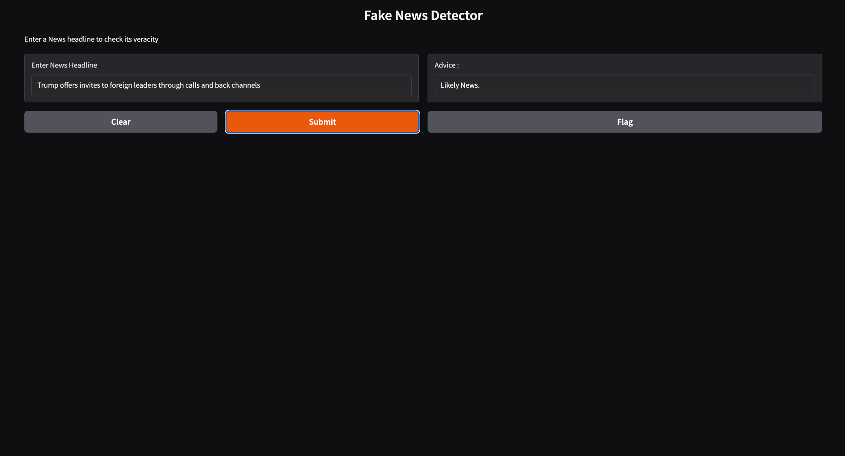
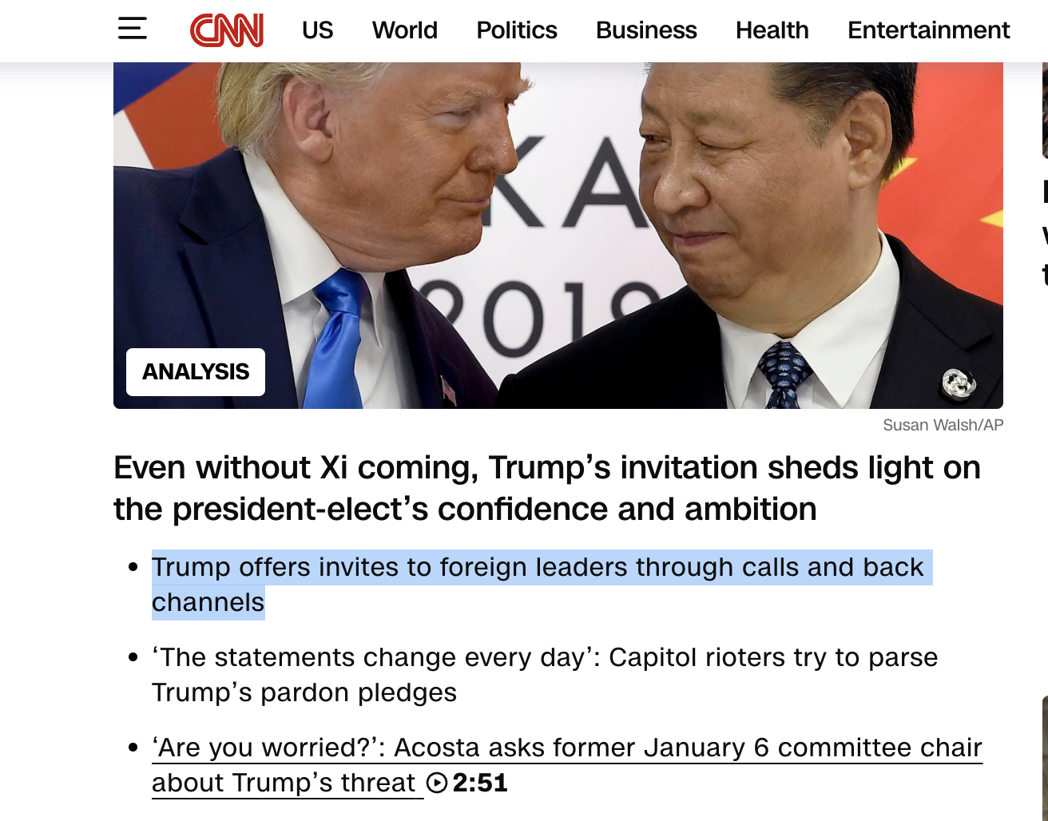
LIVE DEMO
https://182581ea7dc6767f0e.gradio.live
https://182581ea7dc6767f0e.gradio.live
Notes:
Guy

Slide 11
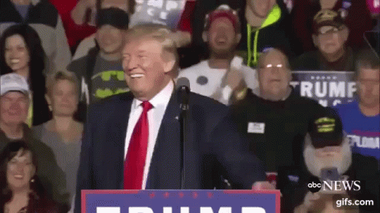
Project overview
Data cleaning is critical to the training and success of the model
Testing all the possible combinations takes a long time, especially when exploring models like SVM and Random Forest
Improving further the model would require depper analysis of the training data set and of the test results
Notes:
Guy

